Slide 1


Statistical Modelling with Data
May 23 – June 02, 2023
Instructor: Qing (Leah) Li, Ph.D. Candidate at Cumming School of Medicine
qing.li2@uclagary.ca
Thank you Dr. Thuntida Ngamkham for contributing the contents
Thank you Dr. Qingrun Zhang and Dr. Quan Long for contributing some slides

Slide 2
Statistical Modelling with Data
Topic 1: Statistical Modelling
Lecture 1: First-order models with quantitative independent variables
Topic 2: Statistical Modelling with interactions (Assignment 1)
Lecture 2: Interaction effects, quantitative and qualitative variables
Lecture 3: Interaction effects and second-order models
Topic 3: Statistical Model selection (Assignment 2)
Lecture 4: Model selection: Stepwise regression procedures
Lecture 5: Model selection: Forward and Backward selection procedures
Topic 4: Statistical model diagnostics
Lecture 6: Multiple regression diagnostics: verify linearity, independence, and equal variance assumptions.
Lecture 7: Multiple regression diagnostics: verify normality assumptions and identify multicollinearity and outliers.
Lecture 8: Multiple regression diagnostics: data transformation
Topic 5: Transfer learning
Lecture 9: Transfer-learning (Bonus): standing on the shoulders of giants.

Slide 3
Statistical Modelling with Data
Topic 1: Statistical Modelling
Lecture 1: First-order models with quantitative independent variables
Topic 2: Statistical Modelling with interactions (Assignment 1)
Lecture 2: Interaction effects, quantitative and qualitative variables
Lecture 3: Interaction effects and second-order models
Topic 3: Statistical Model selection (Assignment 2)
Lecture 4: Model selection: Stepwise regression procedures
Lecture 5: Model selection: Forward and Backward selection procedures
Topic 4: Statistical model diagnostics
Lecture 6: Multiple regression diagnostics: verify linearity, independence, and equal variance assumptions.
Lecture 7: Multiple regression diagnostics: verify normality assumptions and identify multicollinearity and outliers.
Lecture 8: Multiple regression diagnostics: data transformation
Topic 5: Transfer learning
Lecture 9: Transfer-learning (Bonus): standing on the shoulders of giants.
Notes:
The first lecture does not frighten you. I hope you can still bare with my English with accents for the rest of courses.
Many I ask some of your feedbacks for yesterday’s courses? You know these courses won’t be graded and all we ask is to attend six lectures to get the certificate. However, there must be something more than certificate you want to get from this course. I hope that I can really help you understand some basics of statistical modelling. I am not sure what’s your exceptions from this course.

Slide 4
Statistical Modelling with Data
Learning Outcomes: At the end of the course, participants will be able to
Model the multiple linear relationships between a response variable (Y) and all explanatory variables (both categorical and numerical variables) with interaction terms. Interpret model parameter estimates, construct confidence intervals for regression coefficients, evaluate model fits, and visualize correlations between a response variable (Y) and all explanatory variables (X) by graphs (scatter plot, residual plot) to assess model validity.
Predict the response variable at a certain level of the explanatory variables once the fit model exists.
Implement R-software and analyze statistical results for biomedical and other data.
Evaluations
Assignments will be posted on Slack (our communication tool with students).
Students must attend 70% (6/9) of the sessions in order to receive the certificate and are encouraged to work on the assignments progressively throughout the course as the relevant material is covered.

Slide 5

Statistical Modelling with Data
Supportive materials
Lectures slides (2023)
R code scripts (2023)
PDF (dated 2022)
Two Assignments (dated 2022)
Slack channels
Recoding videos
Exercises
Course-documents

Slide 6
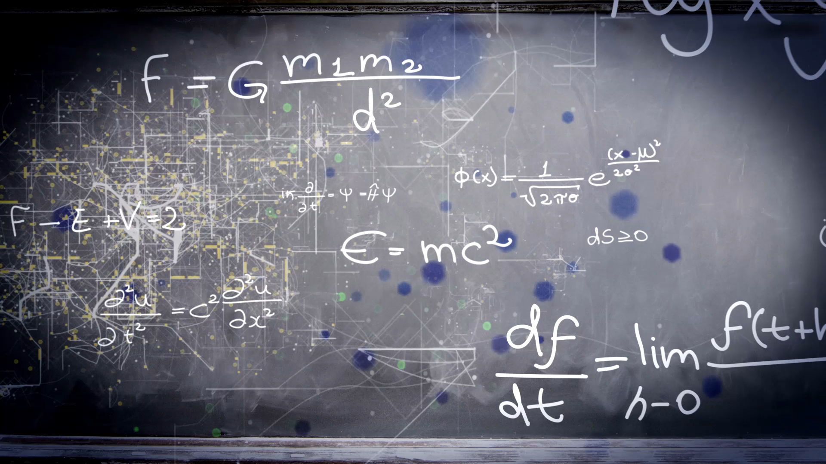
Lecture 3: Multivariate linear regression Interaction effect and A Quadratic (Second-Order) Model with Quantitative Predictors

Slide 7
Quick recap of lecture 2
Statistics:
Interactions: x1:x2 or (x1+x2)^2 or x1*x2
Dummy coding: the number of dummy variable = the number of levels -1
Interpretation of coefficients
Code:
lm(y ~ x1+x2+(x1+x2)^2)
lm(y ~ factor(x1))
Gender | X1
Male | 1
Female | 0
 | x1 | x2
Assistant | 0 | 0
Associate | 1 | 0
Full | 0 | 1

Slide 8
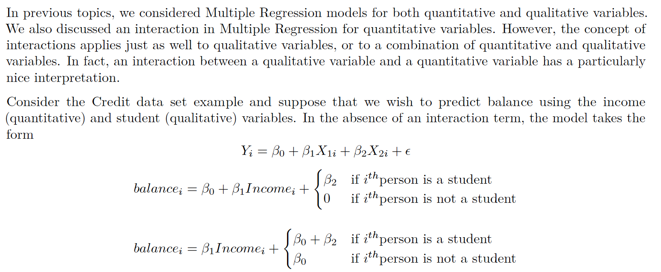
Interaction Effect in Multiple Regression with both Quantitative and Qualitative (Dummy) Variable models

Slide 9
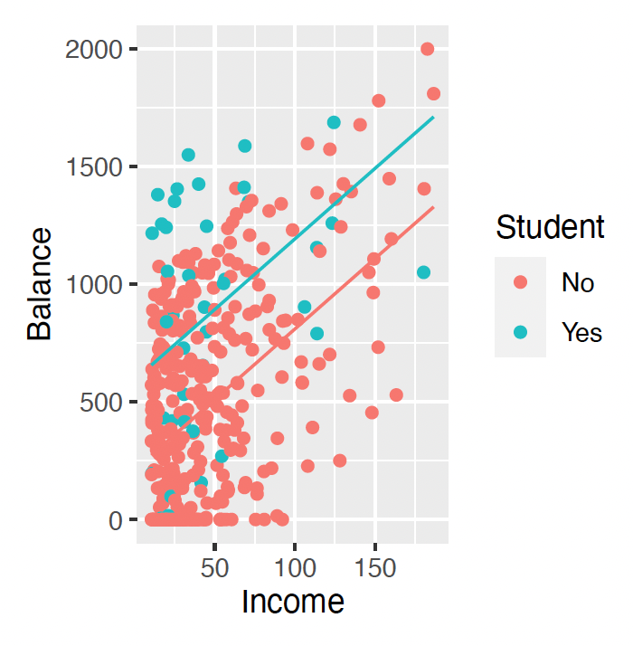
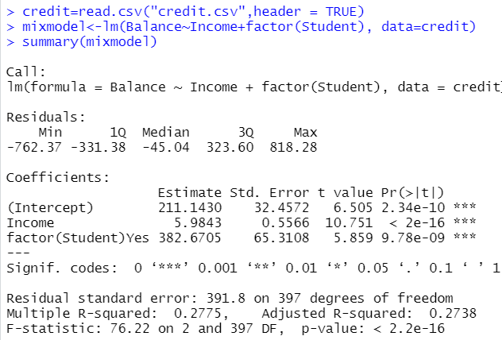
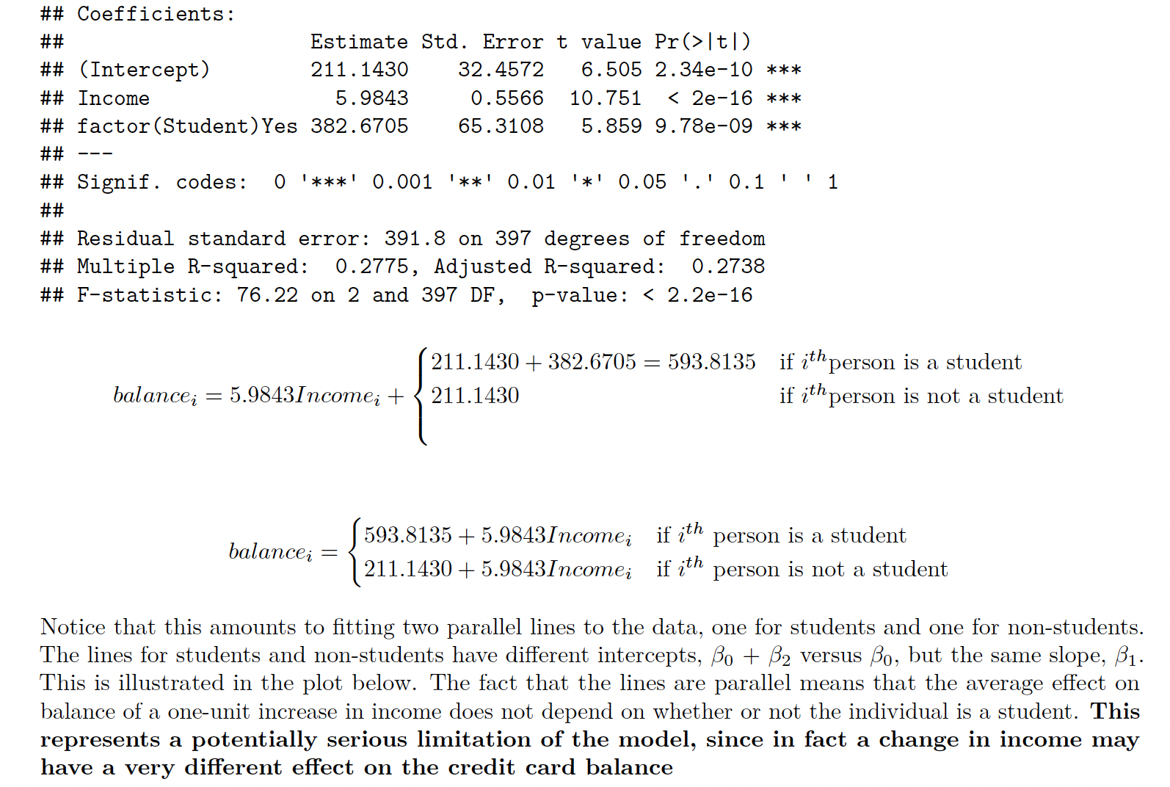
Interaction Effect in Multiple Regression with both Quantitative and Qualitative (Dummy) Variable models
The fact that the lines are parallel means that the average effect on balance of a one-unit increase in income does not depend on whether or not the individual is a student.
This represents a potentially serious limitation of the model, since in fact a change in income may have a very different effect on the credit card balance.

Slide 10
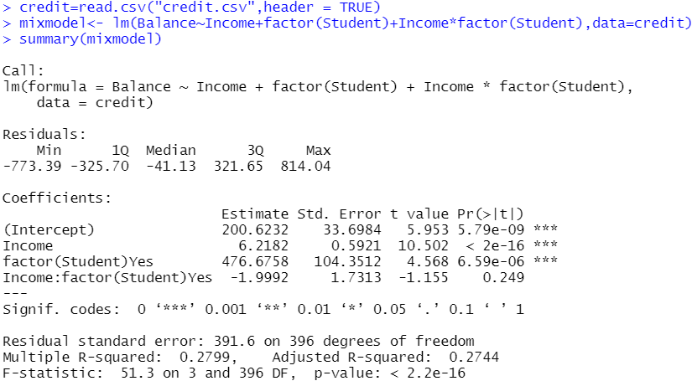
Interaction Effect in Multiple Regression with both Quantitative and Qualitative (Dummy) Variable models

Slide 11
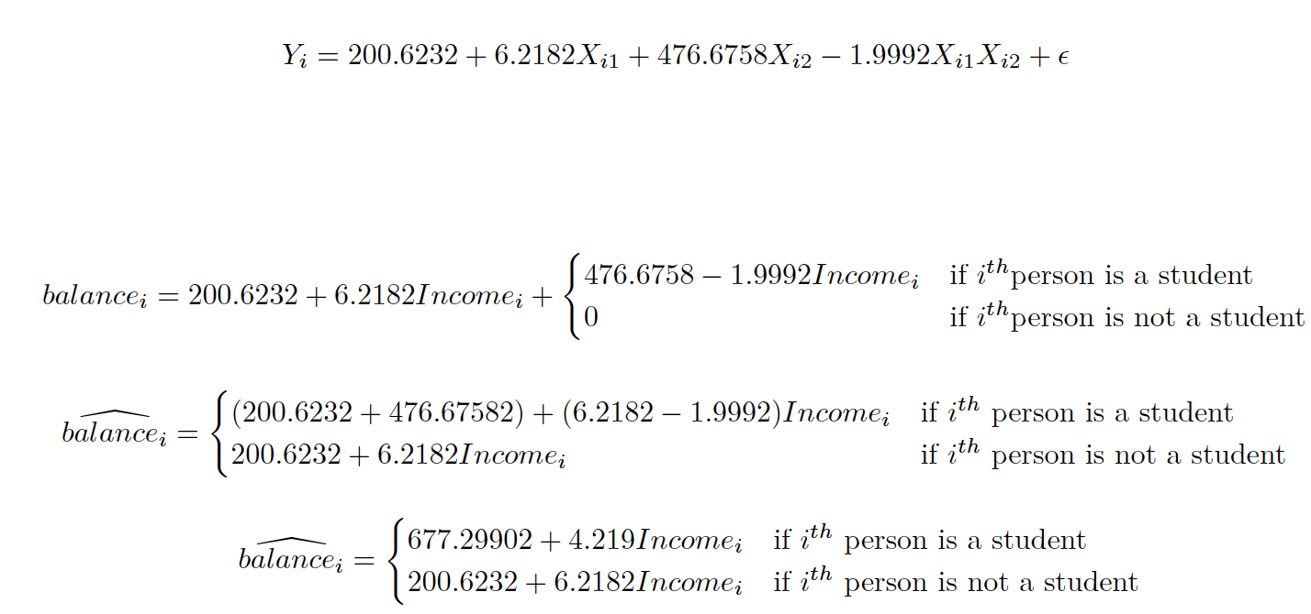
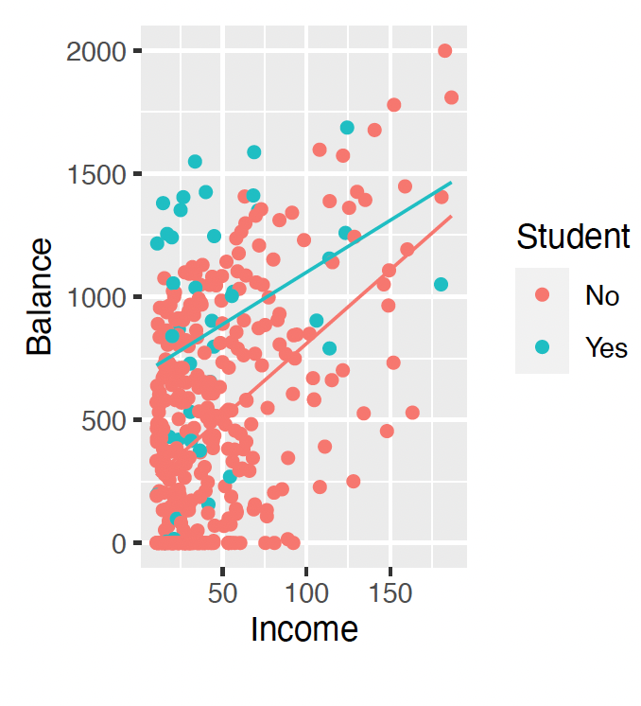
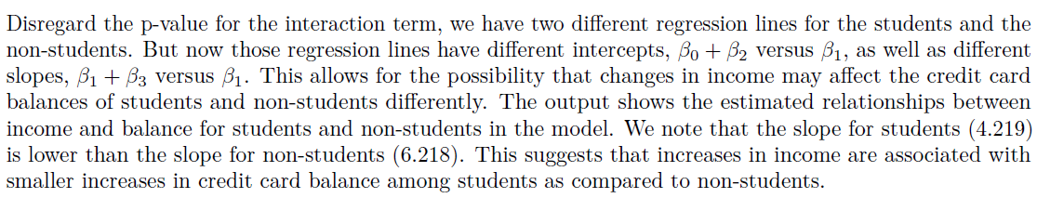
Interaction Effect in Multiple Regression with both Quantitative and Qualitative (Dummy) Variable models

Slide 12


In class Practice Problem 8
From the credit card example, use the lm() function to perform the best-fit model. How would you interpret the regression coefficients (if possible)? Would you recommend this model for predictive purposes?
Build a full additive model with only significant predictors
Build interaction model with predictors from 1
Remove non-significant interactions and rerun the model
Interpret the final model
Hints:
Build an additive model
Determine significant predictors
Build an interaction model with significant predictors
Remove non-significant interactions
Rerun model to ensure all predictors are significant
Iterate at step 5 until done
Lecture_3.R
12

Slide 13
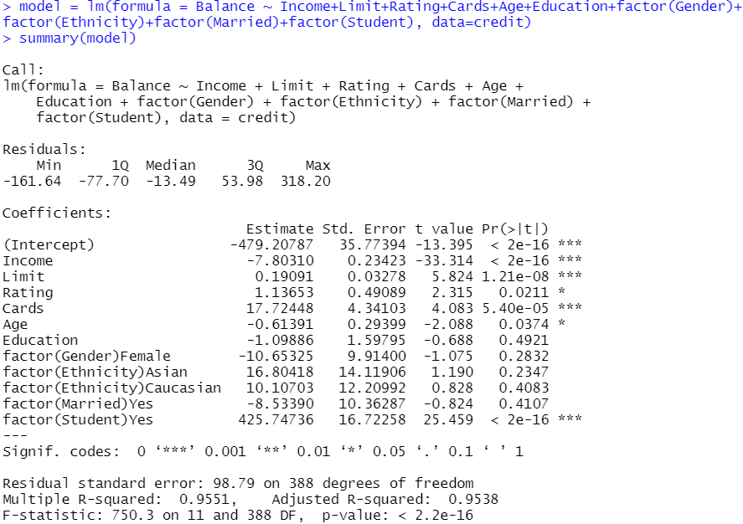
In class Practice Problem 8
1. Build a full additive model with only significant predictors
Lecture_3.R
13

Slide 14
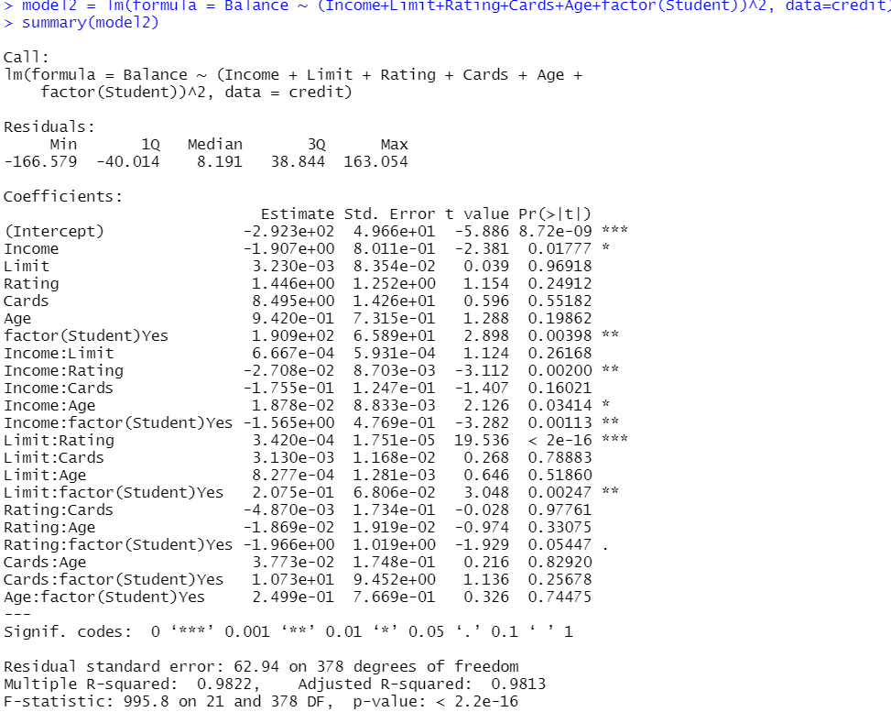
In class Practice Problem 8
2. Build interacting model with predictors from 1
Lecture_3.R
14

Slide 15
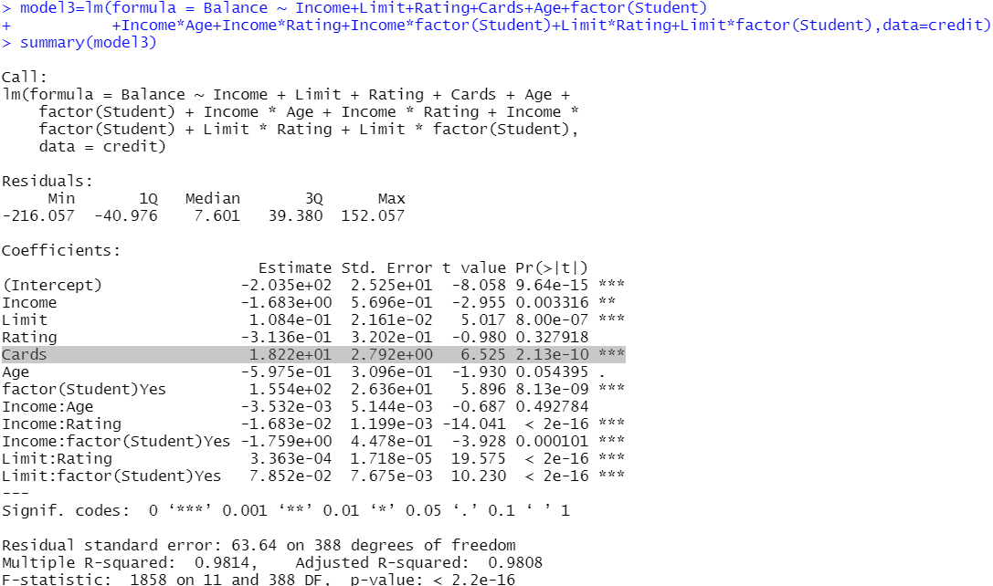
In class Practice Problem 8
3. Remove non-significant interactions and rerun the model
Lecture_3.R
15

Slide 16
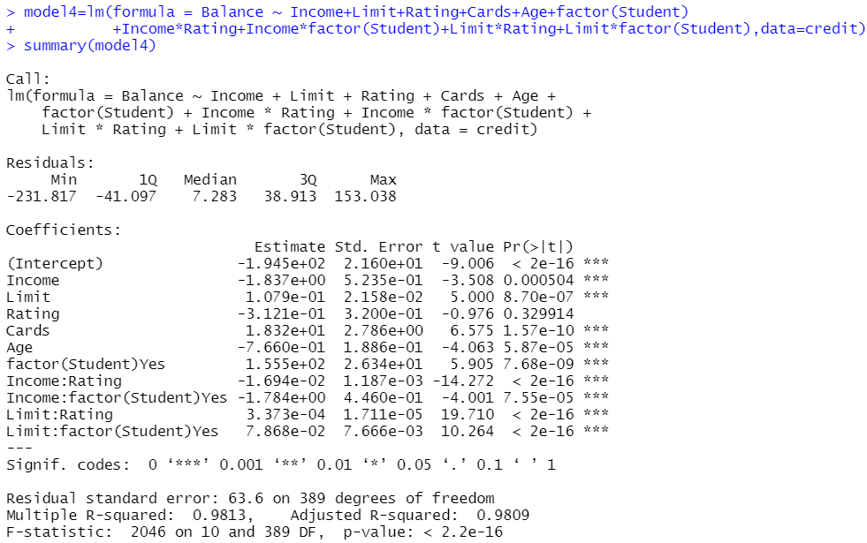
In class Practice Problem 8
3. Remove non-significant interactions and rerun the model
Lecture_3.R
16

Slide 17
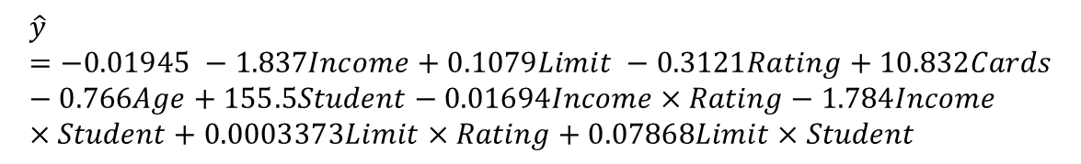
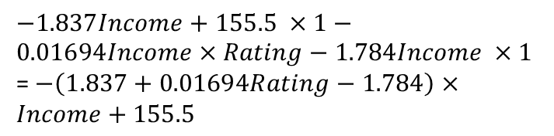
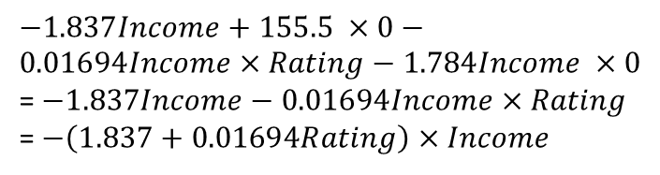
In class Practice Problem 8
4. Interpret the final model
$$\hat{y}=−0.01945 −1.837Income+0.1079Limit −0.3121Rating+10.832Cards−0.766Age+155.5Student−0.01694Income×Rating−1.784Income×Student+0.0003373Limit×Rating+0.07868Limit×Student$$
What is the effect of income on final credit balance if not a student?
$−1.837Income+155.5 ×0−0.01694Income×Rating−1.784Income ×0$
= $−1.837Income−0.01694Income×Rating$
= $−\left(1.837+0.01694Rating\right)×Income$
If not a student, with income increase, credit balance decreases. The person is likely to spend more.
What is the effect of income on final credit balance if a student?
$−1.837Income+155.5 ×1−0.01694Income×Rating−1.784Income ×1$
= $−\left(1.837+0.01694Rating−1.784\right)×Income+155.5$
If a student, with income increase, credit balance likely to increase decreases. The student is likely to spend less.
Lecture_3.R
17

Slide 18
In class Practice Problem 8
Dr. Thuntida Ngamkham’s approach
Build an additive model
Determine significant predictors
Build an interaction model with significant predictors
Remove non-significant interactions
Rerun model to ensure all predictors are significant
Iterate at step 5 until done
Leah’s approach:
Start with an interaction model with all predictors
Remove non-significant interactions
Rerun model to ensure all predictors are significant
Iterate step 3 until done.
Lecture_3.R
18
Notes:
I cannot remember every word from Kelsey’s question, but I think what she wants to ask is why only include interaction terms between predictors with significant main effects. Kelsey, please correct me if I was wrong. That’s an excellent question! If you recall from in-class practice problem 5, we said that removing non-significant individual predictors first and only placing these significant predictor’s interaction terms is some how risky. I will pull out the slides for problem 5 to help you refresh your memory.
So at lecture 2, I suggest you to build an interaction model with all predictors. However, in this class practice problem 8, my colleague Dr. , who is the last year’s instructor for section II proposed to build an additive model first, then …
Her technique runs the danger of overlooking certain interaction variables, as seen in issue 5. During yesterday’s lecture, I mentioned that my suggested approach is different from Dr. but these two can lead to the same results.
Last night I did some experiments using my approach and indeed prove that these two approaches lead to the same results. Let’s me show you details. Before talking about my approach, let’s go over Dr. approach first.

Slide 19
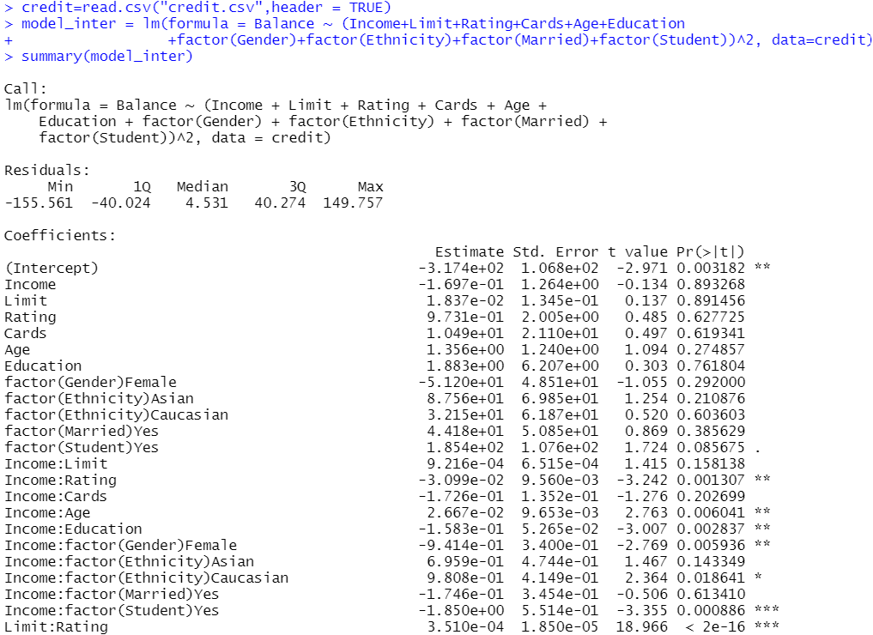
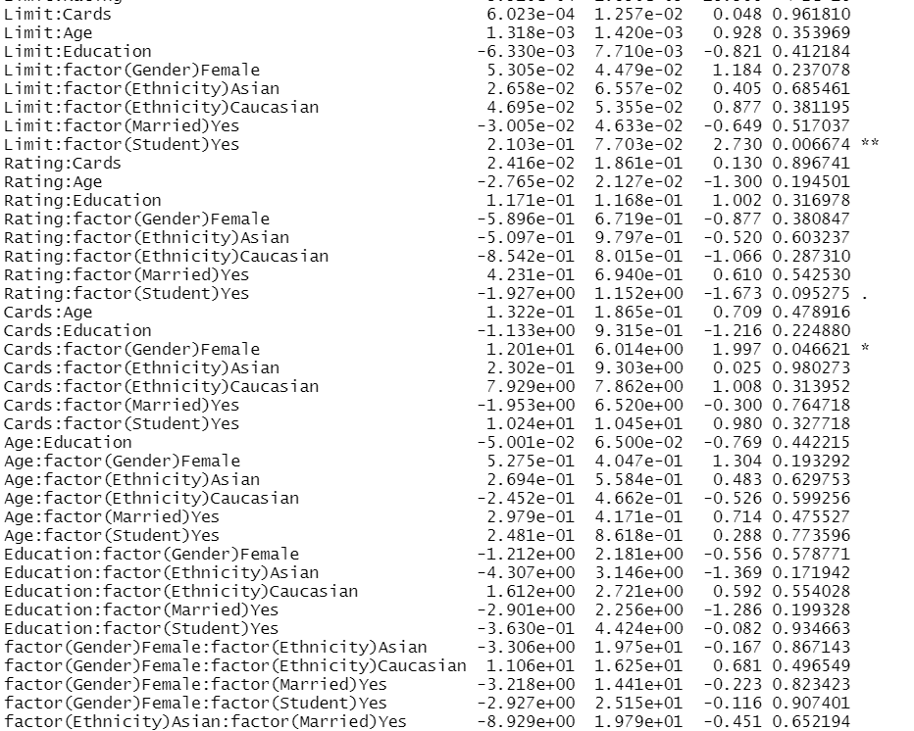
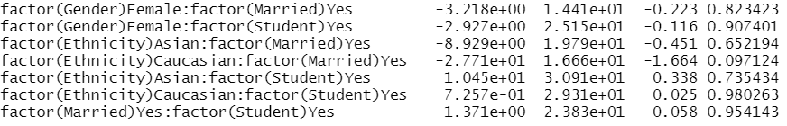
In class Practice Problem 8
Lecture_3.R
19
Notes:
Here are the results using my approach. All code are included in Lecture_3.R file.
For the beginning, as I don’t know which predictor to exclude and I have no idea about their interaction, I take all of them into account.

Slide 20
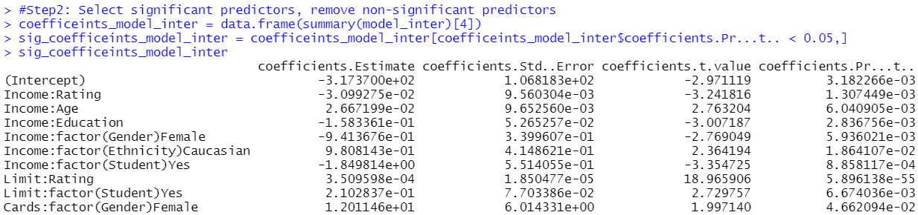
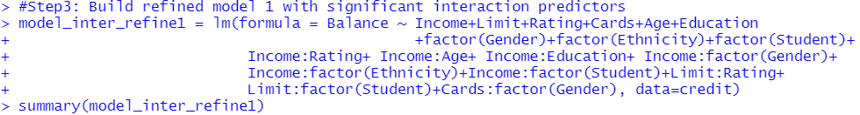
In class Practice Problem 8
Lecture_3.R
20
Notes:
Then I remove interaction predictors with non-significant coefficients. I call that model …

Slide 21
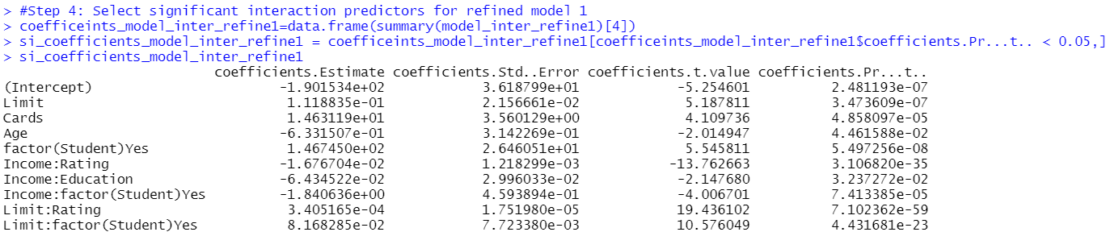
In class Practice Problem 8
Lecture_3.R
21

Slide 22
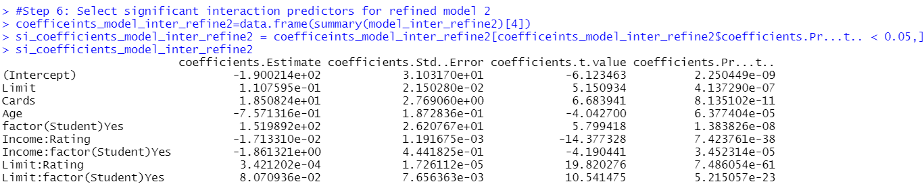
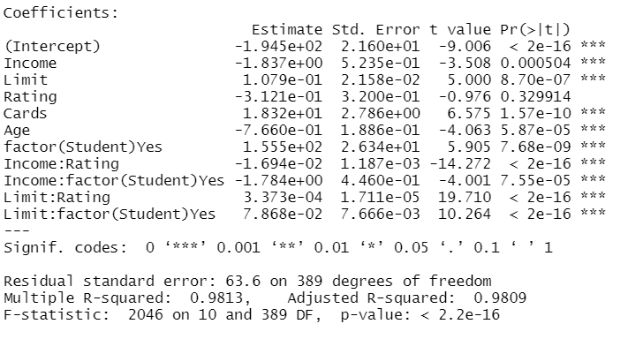
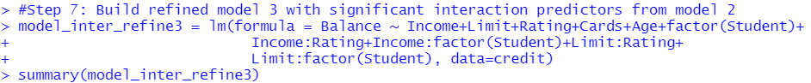
In class Practice Problem 8
Lecture_3.R
22

Slide 23
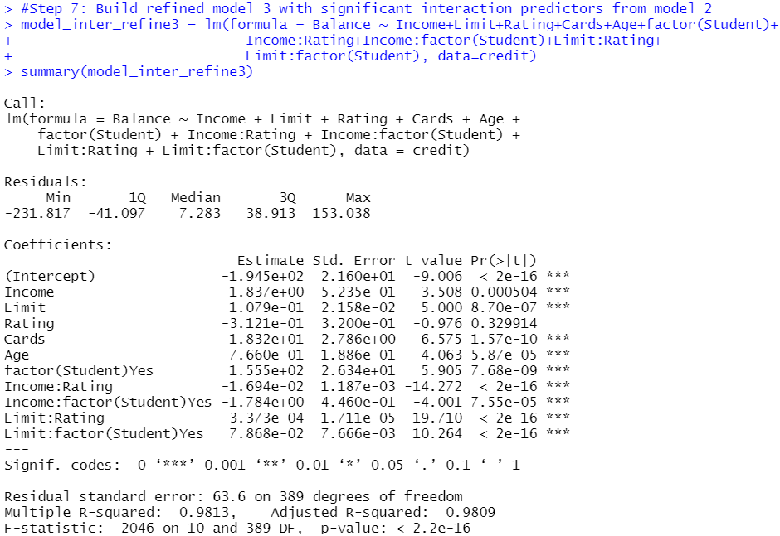
In class Practice Problem 8
Dr. Thuntida Ngamkham’s final model
Leah’s final model
Lecture_3.R
23
Notes:
At last, you will find my final model is exactly the same as Dr.

Slide 24
In class Practice Problem 8
Dr. Thuntida Ngamkham’s approach
Build an additive model
Determine significant predictors
Build an interaction model with significant predictors
Remove non-significant interactions
Rerun model to ensure all predictors are significant
Iterate at step 5 until done
Leah’s approach:
Start with an interaction model with all predictors
Remove non-significant interactions
Rerun model to ensure all predictors are significant
Iterate step 3 until done.
Either way works, and they lead to the same results for problem 8!
Pros:
Cons
Involve a small number of interaction predictors to keep model simple.
Risk of missing some interaction predictors.
Pros:
Cons
Got a really long list of coefficients. Not very eyes-friendly.
No risk of missing any interaction predictors.
Lecture_3.R
24
Notes:
Here I listed pros and cons for these two approaches.
Know you know each approach to build a model with quantitative and qualitative variables and you also know their strengths and drawbacks. You can decided which one to use at your end.

Slide 25
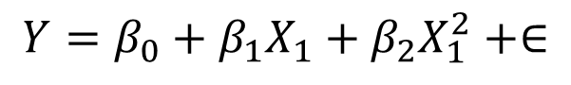
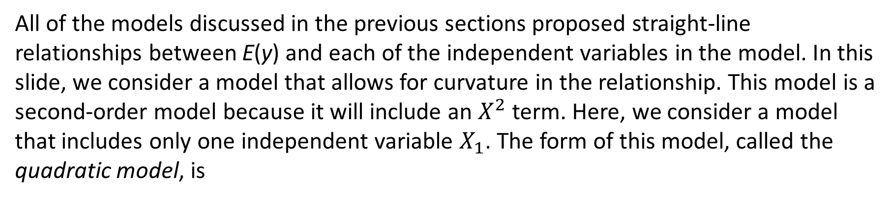
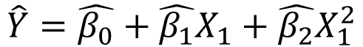
A Quadratic (Second Order) Model with Quantitative predictors
All of the models discussed in the previous sections proposed straight-line relationships between E(y) and each of the independent variables in the model. In this slide, we consider a model that allows for curvature in the relationship. This model is a second-order model because it will include an $X^{2}$ term. Here, we consider a model that includes only one independent variable $X_{1}$. The form of this model, called the quadratic model, is
$$Y=β_{0}+β_{1}X_{1}+β_{2}X_{1}^{2}+∈$$
$$\hat{Y}=\hat{β_{0}}+\hat{β_{1}}X_{1}+\hat{β_{2}}X_{1}^{2}$$
How to interpret the regression coefficients?
How to let R know we are putting higher order term?
Notes:
Let’s move on to new knowledge points for today.

Slide 26
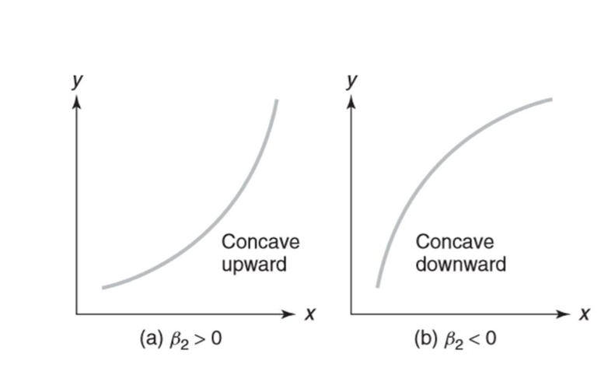
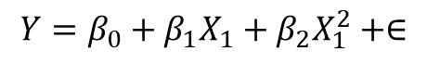
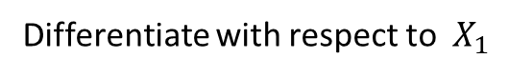
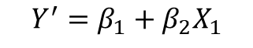
Interpretation of the regression coefficients
$$Y=β_{0}+β_{1}X_{1}+β_{2}X_{1}^{2}+∈$$
Differentiate with respect to $X_{1}$
$$Y^{′}=β_{1}+β_{2}X_{1}$$
$\hat{β_{0}}$ can be meaningfully interpreted only if the range of the independent variable includes zero-that is, if $X_{1}$ = 0 is included in the sampled range of $X_{1}$.
$\hat{β_{1}}$ no longer represents a slope in the presence of the quadratic term $X_{1}^{2}$. The estimated coefficient of the first-order term $X_{1}$ will not, in general, have a meaningful interpretation in the quadratic model.
The sign of the coefficients, $\hat{β_{2}}$ is the indicator of whether the curve is concave downward (mound-shaped) or concave upward (bowl-shaped). A negative $\hat{β_{2}}$ implies downward concavity, as in this example, and a positive $\hat{β_{2}}$ implies upward concavity.

Slide 27
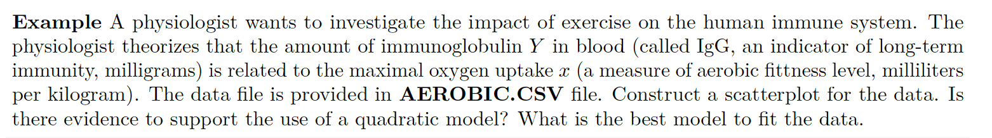
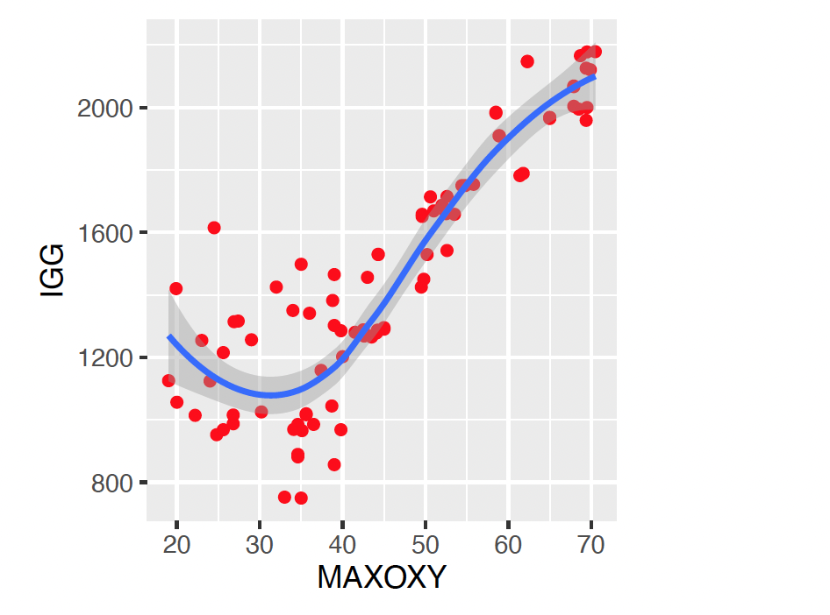
Example: obviously nonlinear

Slide 28
Higher-order models

Slide 29
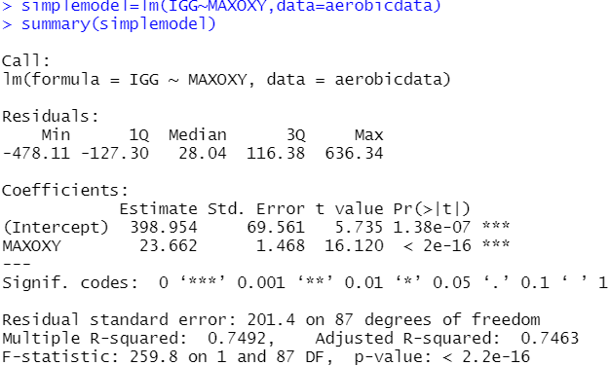
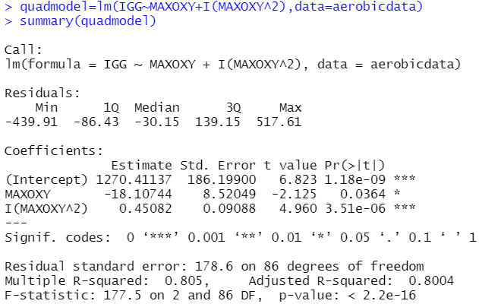
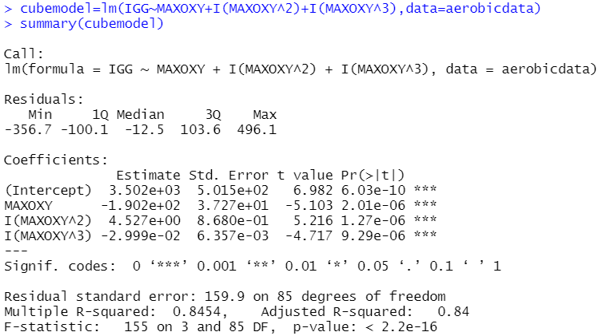
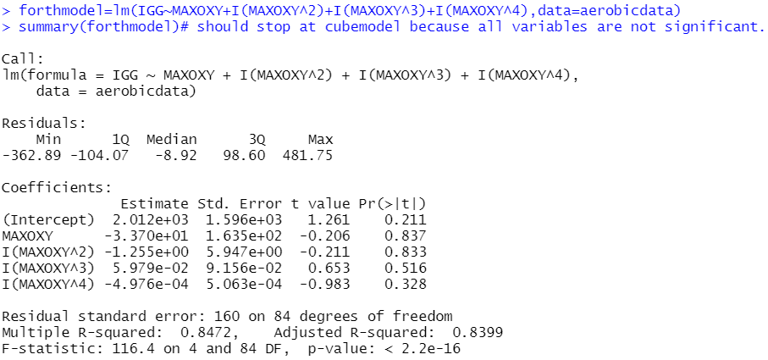
Higher-order models
I(Xˆ2) :add quadratic term to the model

Slide 30
Higher-order models
From the output, considering the scatterplot between Y and 𝑋1, we found that the best model to fit the data is
Moreover, R2 adj = 0.84 and RMSE=159.9,with the lowest RMSE and highest R2 adj among four models. We can conclude that the cube model fits the data better than the simple linear regression model.
Note! Model interpretations are not meaningful outside the range of the independent variable. Although the model appears to support the data. To make a prediction for Y , value of X should be inside the range of the independent variable. Otherwise, the prediction will not be meaningful.
$$\hat{Y}=3502 −190.2X_{1}+4.527X_{1}^{2}−299.9X_{1}^{3}$$

Slide 31

In class Practice Problem 9
Suppose you wanted to model the quality, y, of a product as a function of the pressure pounds per square inch (psi), at which it is produced.
Four inspectors independently assign a quality score between 0 and 100 to each product, and then the quality, y, is calculated by averaging the four scores.
Fit a second-order model to the data and sketch the scatterplot. The data are provided in PRODQUAL.csv file
Which order would you select?

Slide 32
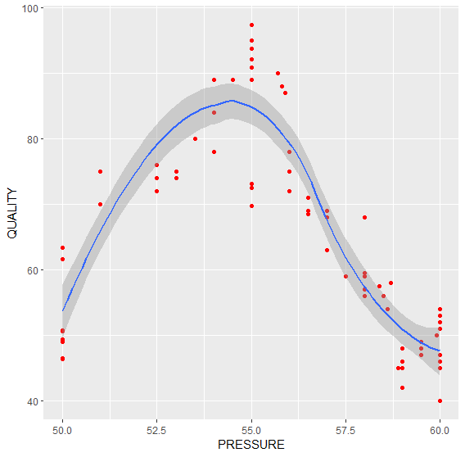
In class Practice Problem 9
ggplot(data=quality)+aes(x=PRESSURE, y=QUALITY)+geom_point(color='red')+geom_smooth()

Slide 33
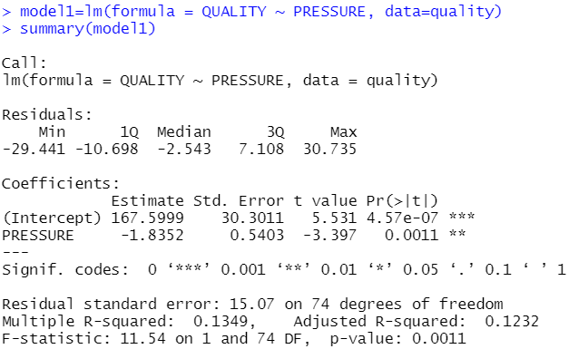
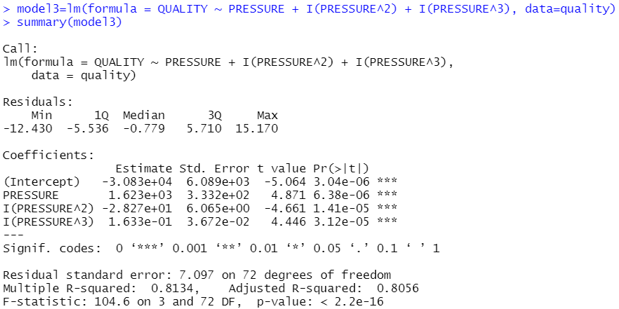
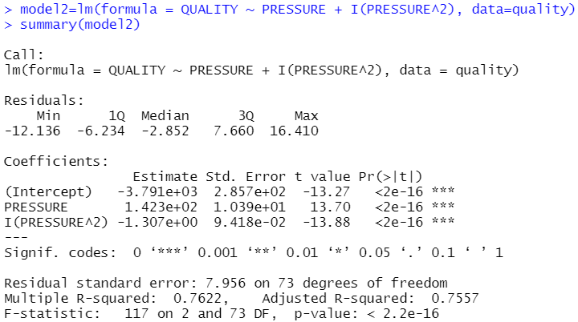
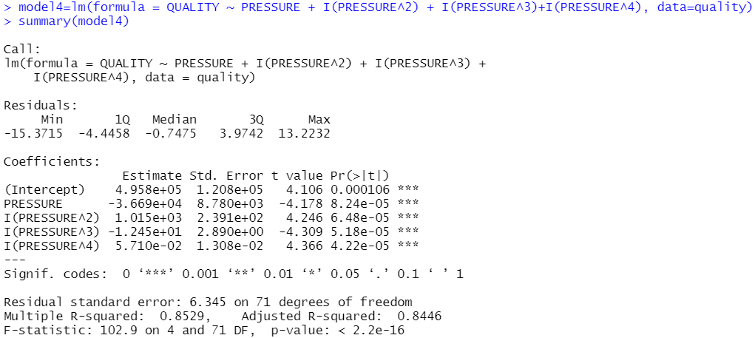
In class Practice Problem 9

Slide 34
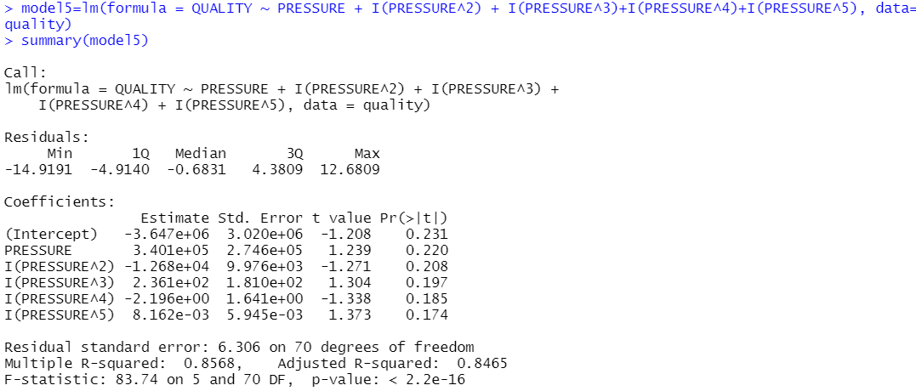
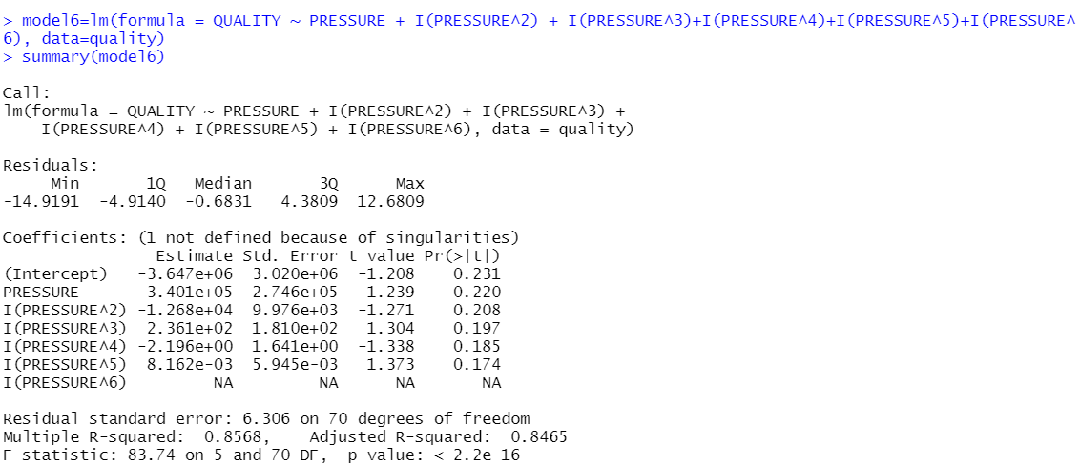
In class Practice Problem 9
Notes:
Coefficient from model 5 are not significant. The same for model 6. In model 6, coefficient for pressure to the six power does not exist. It indicates this pressure to the six power is out of its capacity of parameter estimation.

Slide 35
In class Practice Problem 9
Adjusted R2: model 5 > model 4 > model 3> model 2 > model 1.
RMSE: model 5 < model 4 < model 3 < model 2 < model 1.
Which order /model should we choose? [model 5]
Too many predictors? Overfitting?
Notes:
If you recall from lecture 1, we prefer model with higher adjusted R2 and lower RMSE. So which model will you choose?
Based on these two criteria model 5 is the optimal. But maybe we are risking of overfitting. Overfitting refers to a situation in machine learning or statistical modeling when a model learns and fits the data too well, to the extent that it starts to capture noise and random fluctuations in the data instead of the underlying patterns or relationships. Let’s have a close look at it after the break!

Slide 36

Coffee break
Notes:
"It's time for a break!"
"Let's take a moment to relax and recharge."
"Enjoy your break!"
"Take this opportunity to unwind and refresh."
"We've worked hard, now it's time to take a breather."
"Let's step away from our tasks for a little while."
"Use this break to stretch, grab a snack, or do something enjoyable."
"Take a well-deserved break and come back feeling rejuvenated."
"Pause for a moment and give yourself a chance to rest."
"Take this break to clear your mind and come back with renewed focus.“
"Welcome back, everyone!"
"I hope you enjoyed your break. Let's get back to work."
"I hope you're feeling refreshed and ready to dive back in."
"Alright, let's pick up where we left off before the break."
"I hope the break provided the energy boost we needed. Let's continue our progress."
"I'm glad to see everyone back. Let's resume our tasks."
"I hope you had a productive break. Now let's continue with our work."
"Let's refocus and get back into the flow of things."
"Welcome back, team! Let's make the most of our time remaining."
"I trust everyone had a rejuvenating break. Now let's hit the ground running.“

Slide 37
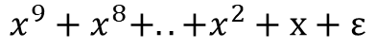
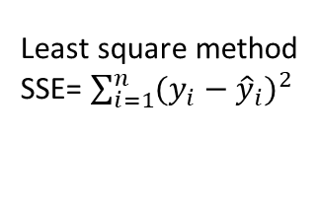
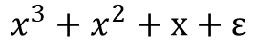
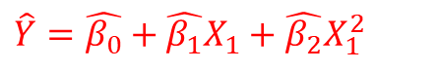




Which model should we choose?
N = 10
N = 15
M = 9
$$Y=sin⁡(x)+ε$$
$$x+ε$$
$${x^{9}+x^{8}+..+x}^{2}+x+ε$$
$$\hat{Y}=\hat{β_{0}}+\hat{β_{1}}X_{1}+\hat{β_{2}}X_{1}^{2}$$
This is the best model as read line is the closest to green line
MSE: this is the optimal model as it has lowest MSE
Least square method
SSE= $\sum_{i=1}^{n}{{(y_{i}−{\hat{y}}_{i})}^{2}}$
N = 100
M = 9
$$x^{3}+x^{2}+x+ε$$
$${x^{9}+x^{8}+..+x}^{2}+x+ε$$
$${x^{9}+x^{8}+..+x}^{2}+x+ε$$
M = degree of polynomial
N = sample size
Bishop 2006, Pattern Recognition and Machine Learning
Notes:
Let now look at an example of using high-order models. Suppose we have 10 samples, show by these blue dots. The green line represent the actual function which generate these ten dots. The red line is our statistical model which intend to approximate the actual model. We build a statistical model with different number of high orders and we wish our statistical model can mimic the actual model. In another word, We hope that the red line and the green line may overlap or that the red line is very near to the green line. As you can tell from left top panel of the figure, when there is no x involved, the red line is horizontal which does not close to green line at all. Even though it only pass through several dots, but it quite far away from many dots.
Then we start introduce x, the line became slanted and formed an angle with the x axis. Now the distance between dots and red line decrease. That is this right top panel. If we add x to the power of 2 and x to the power of three, the red line becomes really close to the green line and they share the same shape. If we keep adding high order predictors to our statistical model, we find the shape of red line becomes quite curved. Based on the shape of red line, which one do you think is the best? I think you will agree with me that this one in the left bottom is the best.
However, when doing statistical modelling, we have no idea what the green line is. What we do is to build a model and we choose model based on some rubrics and we hope our best model is quite close the actual model. If you still remember that in lecture 1 we talked about adjusted R square and MSE and we said we consider model with highest R square and lowest MSE is the optimal model. As we can tell from SSE formula, the closer that y and y hat is, the smaller value the SSE is. So, this last model has lowest MSE as all Y and Y hat overlapped. So, based on MSE, we consider the last model is the best. But we know that model 3 is the closest one to the actual model. Oh, no, MSE gives us an incorrect answer! Can we still rely on MSE to select the best model? The answer is yes but we need to a technique named “cross validation” while building statistical model! I will talk about it soon.
Now, we start add more samples. Our initial sample size is quite small which is 10. Now we add 5 additional samples. Strikingly, the shape of last model change dramatically! It is much close to the green line now. If we increase sample size up to 100, the red line overlapped with green line. What a wonderful modelling!
To summarize these figures, when samples size is small, fitting models with too many predictors likely to cause some problems. Increasing sample size can help solve these problems.

Slide 38

Which model should we choose?
One can make the model complicated enough so that the MSE is very small.
Overfitting: a scenario in data science where model is too closely or exactly to a particular set of data and may therefore fail to fit to additional data or predict future observations reliably.
Underfitting: another scenario in data science where a data model is unable to capture the relationship between the input and output variables accurately, generating a high error rate on both the training set and unseen data.
We want to avoid overfitting and underfitting and we want have a balanced model.
Notes:
In last slide, I show you that MSE gives us an incorrect answer when sample size is small. This kind of mistake has an official name called overfitting.

Slide 39





Cross validation
Test data
SSE= $\sum_{i=1}^{n}{{(y_{i}−{\hat{y}}_{i})}^{2}}$
Cross-validation is a resampling procedure used to evaluate machine learning models on a limited data sample.
The procedure has a single parameter called k that refers to the number of groups that a given data sample is to be split into. As such, the procedure is often called k-fold cross-validation. When a specific value for k is chosen, it may be used in place of k in the reference to the model, such as k=10 becoming 10-fold cross-validation.
Cross-validation is primarily used in applied machine learning to estimate the performance of a machine learning model on unseen data. That is, to use a limited sample in order to estimate how the model is expected to perform in general when used to make predictions on data not used during the training of the model.
It is a popular method because it is simple to understand and because it generally results in a less biased or less optimistic estimate of the model performance than other methods, such as a simple train/test split.
K=4
Test data
SSE= $\sum_{i=1}^{n}{{(y_{i}−{\hat{y}}_{i})}^{2}}$
Test data
SSE= $\sum_{i=1}^{n}{{(y_{i}−{\hat{y}}_{i})}^{2}}$
Test data
SSE= $\sum_{i=1}^{n}{{(y_{i}−{\hat{y}}_{i})}^{2}}$
Notes:
Now you know that we can use cross validation to fit against overfitting. Then what is cross validation?
Dot 1
Dot 2
This figure show you detailed meaning of K. Suppose these dots are our samples. We split data in k folders. reserve some samples, these samples won’t be use to train models and we name them as test data. The rest samples, which are used to train models, are named as train data. To train model, I mean to estimate betas in the model.
Then we reserve another part of samples as test data and train our model on another training data. We can repeat it K times.
As we split data into train and test, we now only calculated MSE in our test dataset.

Slide 40


Which model should we choose?
Training data
Least square method
SSE= $\sum_{i=1}^{n}{{(y_{i}−{\hat{y}}_{i})}^{2}}$
Notes:
Now you know the train and test data. If we go back to our previous LSE method we will can consider it use all data as training data then calculated the MSE in the training data. So if the model include more predictors, SSE always tend to decrease.

Slide 41






Which model should we choose?
$$\sum_{i=1}^{n}{{(y_{i}−{\hat{y}}_{i})}^{2}}$$
RMSE
$$x+ε$$
$${x^{9}+x^{8}+..+x}^{2}+x+ε$$
Underfitting Balanced Overfitting
Notes:
This figure illustrate the relationship between model complexity and MSE in train and test data.
Model with low complexity means
Model with high complexity means

Slide 42

Cross validation (DAAG)
Package “DAAG”: Data Analysis And Graphing. The ‘DAAG’ package contains three functions for k – fold cross validation; the ‘cv.lm’ function is used for simple linear regression models, the ‘CVlm’ function is used for multiple linear regression models, and the ‘CVbinary’ function is used for logistic regression models. The k –fold method randomly removes k – folds for the testing set and models the remaining (training set) data.
R command: library(DAAG); CVlm(data, form.lm, m=3)
The input data frame is returned, with additional columns Predicted (Predicted values using all observations) and cvpred (cross-validation predictions). The cross-validation residual sum of squares (ss) and degrees of freedom (df) are returned as attributes of the data frame.
Here, at the bottom of the output we get the cross validation residual sums of squares (Overall MS); which is a corrected measure of prediction error averaged across all folds. The function also produces a plot of each fold’s predicted values against the actual outcome variable (y); with each fold a different color.
Notes:
I hope you have understand the idea of cross validation. It seems a bit complicated and a lot of work to do. However, there are a lot of packages that can help you to do that in R. Here is an example package named DAAG which can conduct cross validation in R.
“Warning message: As there is >1 explanatory variable, cross-validation predicted values for a fold are not a linear function of corresponding overall predicted values. Lines that are shown for the different folds are approximate”
Warning message is telling you that there is an issue with the generated plot. Apparently, with only a single predictor, the cross-validated predicted values for a fold are a linear function of the overall predicted values. Thus, in the line plot, it seems that the line plots are exact.
With more than 1 predictor, the cross-validated predicted values are not a linear function of the overall predicted values. Thus, the lines in the plot are just approximate.

Slide 43

In class Practice Problem 8+
Model | Adjusted R2 (+) | RMSE (-)
Model_inter_refine3 | 0.9809 | 63.6

Slide 44

In class Practice Problem 8+
Model | Adjusted R2 | RMSE
Model_inter_refine3 | 0.9809 | 63.6
Model_inter_high_order1 | 0.9852 | 56

Slide 45

In class Practice Problem 8+
Model | Adjusted R2 | RMSE
Model_inter_refine3 | 0.9809 | 63.6
Model_inter_high_order1 | 0.9852 | 56
Model_inter_high_order2 | 0.9855 | 55.35
Is there any overfitting for the last model?

Slide 46


In class Practice Problem 8+
Cross validation with CVlm() function!
Model | Test MSE | Overall mean squared error
Model_inter_refine3 |  | 4378.823
Model_inter_high_order1 |  | 3320.602
Model_inter_high_order2 |  | 3330.393

Slide 47


In class Practice Problem 8+
Cross validation with CVlm() function!
Model | Test MSE | Overall mean squared error
Model_inter_refine3 |  | 4378.823
Model_inter_high_order1 |  | 3320.602
Model_inter_high_order2 |  | 3330.393

Slide 48


In class Practice Problem 8+
Cross validation with CVlm() function!
Model | Test MSE | Overall mean squared error
Model_inter_refine3 |  | 4378.823
Model_inter_high_order1 |  | 3320.602
Model_inter_high_order2 |  | 3330.393

Slide 49

In class Practice Problem 8+
Model | Test MSE | Overall mean squared error
Model_inter_refine3 | 4378.822 | 4378.823
Model_inter_high_order1 | 3320.60 | 3320.602
Model_inter_high_order2 | 3330.393 | 3330.393

Slide 50


In class Practice Problem 8+
Leah: Oops, the last model is overfitting, and the second model seems just right
Underfitting Just-right Overfitting
Model | Adjusted R2 | RMSE
Model_inter_refine3 | 0.9809 | 63.6
Model_inter_high_order1 | 0.9852 | 56
Model_inter_high_order2 | 0.9855 | 55.35
Model | Test MSE | Overall mean squared error
Model_inter_refine3 | 4378.822 | 4378.823
Model_inter_high_order1 | 3320.60 | 3320.602
Model_inter_high_order2 | 3330.393 | 3330.393

Slide 51

Model selection
More about model selection? See you tomorrow at Next lecture

Slide 52
In class Practice Problem 9+
Adjusted R2: model 5 > model 4 > model 3> model 2 > model 1.
RMSE: model 5 < model 4 < model 3 < model 2 < model 1.
Which order /model should we choose based on cross validation?
Notes:
If you recall from lecture 1, we prefer model with higher adjusted R2 and lower RMSE. So which model will you choose?
Based on these two criteria model 5 is the optimal. But maybe we are risking of overfitting. Overfitting refers to a situation in machine learning or statistical modeling when a model learns and fits the data too well, to the extent that it starts to capture noise and random fluctuations in the data instead of the underlying patterns or relationships. Let’s have a close look at it after the break!

Slide 53


Take away messages
Statistics:
Interaction Effect in Multiple Regression with both Quantitative and Qualitative (Dummy) Variable models
Two different approaches but result in the same optimal model
A Quadratic (Second Order) Model with Quantitative predictors
Cross validation to avoid overfitting and underfitting model
Code:
lm(y ~ x1+x2+(x1+x2)^2 + I(X1^2)+I(X2^2))
CVlm()
Notes:
To summarize today’s lecture, we are aware that interactions between some variables can cause great effect on response. So we will include interactions between predictors. We also learned about dummy coding, an efficient way to transfer categorical data into numerical values and take them into statistical models. We've also gone through the explanations of these coefficients in depth so you know what they mean. The R function that I hope you can learn by heart are 1) a plus b whole square 2) factor

Slide 54

Thank you
Questions OR Comments?
Slack channel: section2-course-documents
Email: qing.li2@uclagary.ca

